Slide 1
Clean Intermittent Catheterization
Steps for Teaching Patients

Slide 2
Indications for Clean Intermittent Catheterization
Complications from CIC
Teaching Requirements
Steps for Teaching
Catheters
Catheter Insertion – Lubricants
Tips
Agenda

Slide 3
ICS Glossary - Definitions
Catheterization - intermittent (IC):
Drainage of the bladder or a urinary reservoir with subsequent removal of the catheter mostly at regular intervals
Catheterization - clean intermittent (CIC):
This is the use of a clean technique. This implies ordinary hand and genitals washing techniques and use of disposable or cleansed reusable catheters.
(Gazewski JB, Schurch B, Hamid R, Averbeck M, Sakakibara R, Finalli Agro E, Dickinson T, Payne C, Drake MJ, Haylen BT. An International Continence Society (ICS) Report on the Terminology for Adult Neurogenic Lower Urinary Tract Dysfunction (ANLUTD) Neurourol Urodyn 2017 Nov 17 DOI: 10.1002/nau.23397)

Slide 4
A PDF of these Recommendations is available at: https://unc.org/education/
Or on any of the three other nursing group’s websites.
Notes:
Most of the information in this presentation will be from the Clean Intermittent Urethral Catheterization in Adults: Canadian Best Practice Recommendations For Nurses from April 2020. These Best Practice Recommendations were created by the four following specialty nursing groups: Nurses Specialized in Wound, Ostomy and Continence Canada, Canadian Nurse Continence Advisors, Urology Nurses of Canada, and Infection Prevention and Control Canada. As such, they are available on the each of the nursing group’s websites.

Slide 5
Indications For Intermittent Catheterization
Bladder drainage
Intermittent catheterization (IC) should only be performed in the presence of a residual volume of urine and symptoms or complications resulting from the residual volume.
Dilatation of urethral strictures
With the procedure of passing a urinary catheter or dilator carried out on a regularly scheduled basis, the patency of the bladder neck, urethra, or external urethral meatus may be maintained. This should only be done on medical advice.
(Clean Intermittent Urethral Catheterization in Adults – Canadian Best Practice Recommendations for Nurses. Developed by Nurses Specialized in Wound, Ostomy and Continence Canada, Canadian Nurse Continence Advisors, Urology Nurses of Canada, and Infection Prevention and Control.1st Ed. 2020.)
Notes:
The focus of this presentation will be on CIC as it pertains to bladder drainage not dilatation of urethral strictures.
Next slide lists the complications of a large post void residual of urine.

Slide 6
complications resulting from residual volume.
Urinary tract infection
Bladder calculi
Renal failure
Patient discomfort
Lower urinary tract symptoms, e.g., nocturia,
Urgency, or frequency
Incontinence
(Table 4 - Complications of a large post-void residual volume (PVR) of urine. Clean Intermittent Urethral Catheterization in Adults – Canadian Best Practice Recommendations for Nurses. Developed by Nurses Specialized in Wound, Ostomy and Continence Canada, Canadian Nurse Continence Advisors, Urology Nurses of Canada, and Infection Prevention and Control.1st Ed. 2020)
Notes:
(From page 12 Clean Intermittent Urethral Catheterization in Adults – Canadian Best Practice Recommendations for Nurses. Developed by Nurses Specialized in Wound, Ostomy and Continence Canada, Canadian Nurse Continence Advisors, Urology Nurses of Canada, and Infection Prevention and Control.1st Ed. 2020)

Slide 7
Contraindications To IC for Bladder Drainage
Absolute contraindications:
Urethral rupture/ tear
High intravesical pressure (requires continuous drainage to avoid renal damage)
Relative contraindications:
Poor manual dexterity
Inability to access the perineum (e.g., obesity)
Impairing psychological or cognitive disorder in the absence of an appropriately trained caregiver.
(Clean Intermittent Urethral Catheterization in Adults – Canadian Best Practice Recommendations for Nurses. Developed by Nurses Specialized in Wound, Ostomy and Continence Canada, Canadian Nurse Continence Advisors, Urology Nurses of Canada, and Infection Prevention and Control.1st Ed. 2020.)
Notes:
(from page 13 of Clean Intermittent Urethral Catheterization in Adults – Canadian Best Practice Recommendations for Nurses. Developed by Nurses Specialized in Wound, Ostomy and Continence Canada, Canadian Nurse Continence Advisors, Urology Nurses of Canada, and Infection Prevention and Control.1st Ed. 2020)

Slide 8
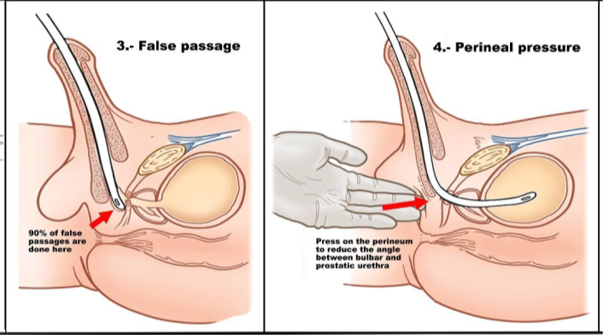
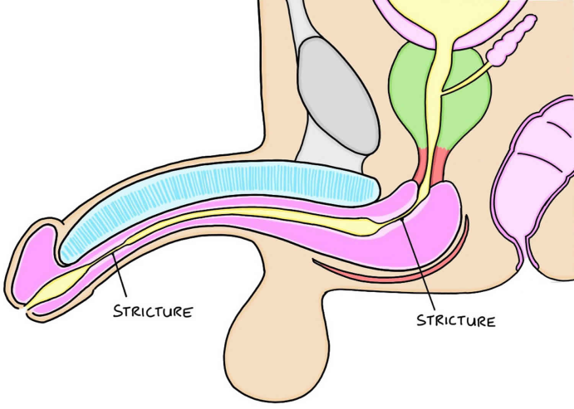
Possible COMPLICATIONS from cic
Urinary tract infection - (UTI) is the most common complication of IC.
Trauma
- Long-term urethral bleeding
- False passage
- Urethral stricture
Miscellaneous
- Bladder calculus
- Pain and discomfort
(Clean Intermittent Urethral Catheterization in Adults – Canadian Best Practice Recommendations for Nurses. Developed by Nurses Specialized in Wound, Ostomy and Continence Canada, Canadian Nurse Continence Advisors, Urology Nurses of Canada, and Infection Prevention and Control.1st Ed. 2020.)
Notes:
These are some of the possible complications.
(from page 13 and 14 of Clean Intermittent Urethral Catheterization in Adults – Canadian Best Practice Recommendations for Nurses. Developed by Nurses Specialized in Wound, Ostomy and Continence Canada, Canadian Nurse Continence Advisors, Urology Nurses of Canada, and Infection Prevention and Control.1st Ed. 2020)

Slide 9
Risk Factors for UTI
Low frequency of IC
Bladder over distension
Female
Poor fluid intake
Non-hydrophilic coating
Poor technique
Poor education
(Table 6- Factors increasing the risk of infection in IC. Reproduced from the EAUN Guidelines 2013, with permission. Clean Intermittent Urethral Catheterization in Adults – Canadian Best Practice Recommendations for Nurses. Developed by Nurses Specialized in Wound, Ostomy and Continence Canada, Canadian Nurse Continence Advisors, Urology Nurses of Canada, and Infection Prevention and Control.1st Ed. 2020.)
Notes:
(From page 16 of Clean Intermittent Urethral Catheterization in Adults – Canadian Best Practice Recommendations for Nurses. Developed by Nurses Specialized in Wound, Ostomy and Continence Canada, Canadian Nurse Continence Advisors, Urology Nurses of Canada, and Infection Prevention and Control.1st Ed. 2020)

Slide 10
Strategies To Reduce UTI In CIC
Hand hygiene
Skin Care and Preparation
Environment and Equipment
Fluid intake (25-35ml/kg/day)
Adequate use of lubricant – consider use of hydrophilic catheters in cases of frequent UTI
Urinalysis – avoid routine use
(Clean Intermittent Urethral Catheterization in Adults – Canadian Best Practice Recommendations for Nurses. Developed by Nurses Specialized in Wound, Ostomy and Continence Canada, Canadian Nurse Continence Advisors, Urology Nurses of Canada, and Infection Prevention and Control.1st Ed. 2020.)
Notes:
Hand hygiene – Extremely important! Patients should thoroughly clean their hands with alcohol-based hand rub or with soap and water, especially if visibly soiled, before catheterization. Hand hygiene is also required before accessing materials.
Skin Care and Preparation - Good genital hygiene, especially before catheter insertion, will reduce the risk of catheter contamination and subsequent infection.
Environment and Equipment - physical environment may contaminate equipment and increase the risk of infection. For IC, the procedure should be done in a clean environment, e.g., surfaces cleaned at minimum before the procedure.
Fluid intake - Drinking adequate fluid helps to dilute the urine and create a downward drainage and flushing effect. Inadequate fluid intake can result in inadequate frequency of bladder emptying. When urine volume is less than 1,200 ml per day, patients are less likely to empty their bladders at regular intervals, resulting in urinary
stasis and bladder distension, conditions that increase the risk of infection. Excessive fluid intake may result in bladder over distension and overflow incontinence.
Adequate use of lubricant – decreased the risk of urethral injury, which can increase the risk of UTI. Hydrophilic catheters have been shown in a number of studies to decrease the frequency of UTI in some patient groups.
Urinalysis - Avoid the routine use of dipsticks to diagnose UTIs as they may provide misleading information. Take a midstream or catheter specimen of urine for culture only if a patient has symptoms suggesting a UTI.
(From page 17 -19 of Clean Intermittent Urethral Catheterization in Adults – Canadian Best Practice Recommendations for Nurses. Developed by Nurses Specialized in Wound, Ostomy and Continence Canada, Canadian Nurse Continence Advisors, Urology Nurses of Canada, and Infection Prevention and Control.1st Ed. 2020)

Slide 11
CIC Teaching Requirements
Motivated Patient and or caregiver
Adequate manual dexterity
Cognitive level - ability to follow and repeat certain steps
Adequate TIME!
(Clean Intermittent Urethral Catheterization in Adults – Canadian Best Practice Recommendations for Nurses. Developed by Nurses Specialized in Wound, Ostomy and Continence Canada, Canadian Nurse Continence Advisors, Urology Nurses of Canada, and Infection Prevention and Control.1st Ed. 2020.)
Notes:
Adequate Time- To adequately teach IC, extended appointment times are required. In the literature, education sessions ranged from one hour to 90 minutes. Patients report the importance of a private and relaxed environment with sufficient time. (from Pg 35 of Clean Intermittent Urethral Catheterization in Adults – Canadian Best Practice Recommendations for Nurses. Developed by Nurses Specialized in Wound, Ostomy and Continence Canada, Canadian Nurse Continence Advisors, Urology Nurses of Canada, and Infection Prevention and Control.1st Ed. 2020)

Slide 12
CIC Teaching Requirements Continued
The prerequisite environment for IC includes:
Privacy
Skilled health professional instruction and support to establish performance
Competency
Access to hand washing or hand sanitizer
Supplies for perineal/urethral meatus cleansing, intermittent catheter, lubricant for a non-lubricated catheter
Receptacle for urine
and place to dispose of supplies.
(Clean Intermittent Urethral Catheterization in Adults – Canadian Best Practice Recommendations for Nurses. Developed by Nurses Specialized in Wound, Ostomy and Continence Canada, Canadian Nurse Continence Advisors, Urology Nurses of Canada, and Infection Prevention and Control.1st Ed. 2020.)
Notes:
(from pg 29 of Clean Intermittent Urethral Catheterization in Adults – Canadian Best Practice Recommendations for Nurses. Developed by Nurses Specialized in Wound, Ostomy and Continence Canada, Canadian Nurse Continence Advisors, Urology Nurses of Canada, and Infection Prevention and Control.1st Ed. 2020)

Slide 13
Teaching Points
Basic anatomy
Underlying etiology that necessitates CIC
Application of step-by-step process of CIC
Frequency of CIC
Catheter types and sizes
Infection control measures – Good Hand Hygiene
Intake and Output Chart
Signs and symptoms and management of UTI
Where to obtain and properly store supplies
(Clean Intermittent Urethral Catheterization in Adults – Canadian Best Practice Recommendations for Nurses. Developed by Nurses Specialized in Wound, Ostomy and Continence Canada, Canadian Nurse Continence Advisors, Urology Nurses of Canada, and Infection Prevention and Control.1st Ed. 2020.)
Notes:
From page 51 of Clean Intermittent Urethral Catheterization in Adults – Canadian Best Practice Recommendations for Nurses.

Slide 14
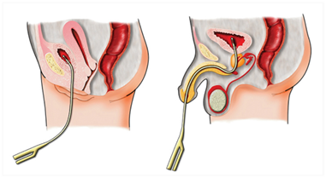
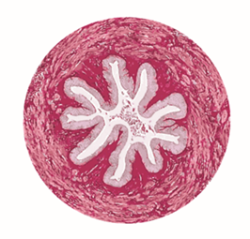
Basic Anatomy of the Urethra
Female urethra is 3-4 cm long, while male urethra is 15-25 cm with a curved path around the prostate to the bladder
Urethral lumen is normally closed and lies flat with longitudinal flattened folds that dilate only to void.¹
Cross-section of a closed urethra
Urethral pain is produced by friction and mechanical stretching when a catheter is inserted^{2,3}
During catheterization, tissue trauma is very likely to occur²
Instillation of lubrication dilates the folds, reducing pain, easing insertion, reducing injury risk¹
Use of an anesthetic lubricating gel vs a lubrication gel alone reduces pain during catheterization for most patients²
Mary Wilson, Catheter lubrication and fixation: interventions, British Journal of Nursing, 2013, Vol 22, No 10 p 566-569
Aygin D, Usta E, The effect of lubricants used in indwelling bladder catheterization through urethra on procedure-related pain: a literature review, Int J Clin Exp Med 2017;10(2):1995-2005, www.ijcem.com
Tzortzis et al, Intraurethral Lubricants: A Critical Literature Review and Recommendations, Journal of Endurology, Vol 23, Number 5, May 2009 p 821-826
Notes:
References
Mary Wilson, Catheter lubrication and fixation: interventions, British Journal of Nursing, 2013, Vol 22, No 10 p 566-569
Aygin D, Usta E, The effect of lubricants used in indwelling bladder catheterization through urethra on procedure-related pain: a literature review, Int J Clin Exp Med 2017;10(2):1995-2005, www.ijcem.com
Tzortzis et al, Intraurethral Lubricants: A Critical Literature Review and Recommendations, Journal of Endurology, Vol 23, Number 5, May 2009 p 821-826

Slide 15
Steps for Teaching CIC Procedure
Have patient void and measure output first then wash their hands.
Have patient gather supplies and place on clean work surface.
Open catheter package, if non-lubricated, remove from package and apply lubricant to first 2-3 inches.
Males - should sit on the toilet or stand facing the toilet, whichever they prefer.
Females - should sit on the toilet with legs spread apart. A mirror may be helpful.
Males- if uncircumcised, pull back foreskin, then wash end of penis with a washcloth and soap and water.
Females- spread labia using their fingers, with the dominant hand use a washcloth and soap and water to wash the vaginal area from front to back.
(Clean Intermittent Urethral Catheterization in Adults – Canadian Best Practice Recommendations for Nurses. Developed by Nurses Specialized in Wound, Ostomy and Continence Canada, Canadian Nurse Continence Advisors, Urology Nurses of Canada, and Infection Prevention and Control.1st Ed. 2020.)
Notes:
1. This will help track how much urine is being retained in patients who are able to void some on their own. This will help when deciding upon frequency of CIC needed for the individual patient.
The inside of the catheter packaging can provide a sterile surface to apply the lubricant and lay the catheter on once lubricated to help reduce contamination.
Both male and female pt can also do CIC while sitting in a chair close to the toilet or on a bed in a lying or semi sitting position. When able to do CIC in the washroom, this helps reduce the time and steps needed for the procedure. i.e. protecting the bed, carrying the urine to the toilet for disposal, etc.
5. Male pt should wash in circular motion starting at the meatus and moving outward.
Disposable wipes may also be used for cleaning.

Slide 16
6. Steps for Teaching CIC
Slowly advance the catheter until some resistance is met (the internal sphincter), hold the catheter at this point for several seconds to allow the sphincter to relax.
Take a deep breath, then exhale while slowly advancing the catheter until it is in the bladder and urine drains from the catheter. .
Alternately, wash and dry hands, hold penis straight up, hold syringe in dominant hand, press on syringe until drop of gel appears, wipe gel on urethra opening, gently insert lubricated tip of syringe into the urethral meatus. Slowly compress syringe letting get flow into urethra, once syringe is empty, remove and put aside. If using Lidocaine gel, wait 5 minutes for anesthetic effect before inserting catheter .
Wash and dry hands, hold penis straight up, hold catheter in dominant hand and gently insert lubricated tip into the urethral meatus.
Males
Females
Locate the urethra while the labia are spread apart after cleaning. This will be a small opening below the clitoris but above the vagina. (A mirror maybe helpful to visualize this.)
Take the catheter in the dominant hand, holding it like a dart, and gently insert the lubricated end into the urethra and bladder until urine drains from the catheter.
Alternately, hold syringe in dominant hand, press on syringe until drop of gel appears, wipe gel on urethra opening, gently insert lubricated tip of syringe into the urethral meatus. Slowly compress syringe letting get flow into urethra, once syringe is empty, remove and put aside. If using Lidocaine gel, wait 5 minutes for anesthetic effect before inserting catheter
(Clean Intermittent Urethral Catheterization in Adults – Canadian Best Practice Recommendations for Nurses. Developed by Nurses Specialized in Wound, Ostomy and Continence Canada, Canadian Nurse Continence Advisors, Urology Nurses of Canada, and Infection Prevention and Control.1st Ed. 2020.)
Notes:
6. Female pts may feel a burning or a pinch as the catheter passes through the urethra – this is normal.
If the catheter has been inserted approx. 3 inches with no urine flow the pt has accidently inserted the catheter into her vagina. Leave it in place and use as a landmark to insert a second catheter above into
the urethra.

Slide 17
Steps for Teaching CIC (Continued)
Allow time for urine to completely drain from the bladder, measuring and recording the output.
Once urine has stopped, slowly remove the catheter, stopping anytime more urine begins to drain from the catheter end.
For uncircumcised males, once the catheter is removed, replace foreskin over the head of the penis.
At this point, the patient can clean themselves and pull their clothes back on.
Discard catheter and packaging into a garbage can and wash hands.
(Clean Intermittent Urethral Catheterization in Adults – Canadian Best Practice Recommendations for Nurses. Developed by Nurses Specialized in Wound, Ostomy and Continence Canada, Canadian Nurse Continence Advisors, Urology Nurses of Canada, and Infection Prevention and Control.1st Ed. 2020.)

Slide 18
FREQUENCY of CIC
Based on the individual patient’s catheterized volumes
500mls or less/ catheterization
If not voiding any on their own- 4-6 times per 24hrs based on urine output
Fluid intake is a primary determining factor as it impacts urine production
General Canadian practice
When residual urine is less than 100ml, CIC can usually be discontinued.
(Clean Intermittent Urethral Catheterization in Adults – Canadian Best Practice Recommendations for Nurses. Developed by Nurses Specialized in Wound, Ostomy and Continence Canada, Canadian Nurse Continence Advisors, Urology Nurses of Canada, and Infection Prevention and Control.1st Ed. 2020.)

Slide 19
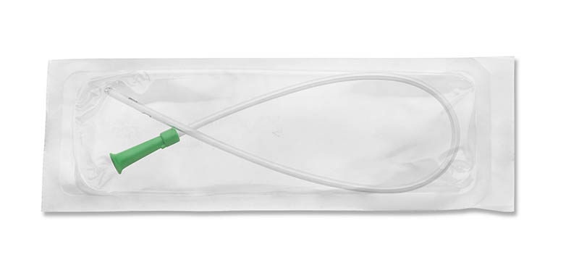
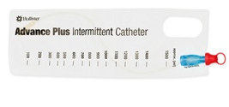
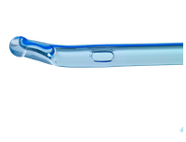
Types of Intermittent catheters
Non Lubricated
Lubricated / Hydrophilic
Hollister VaPro Touch-Free Hydrophilic Intermittent Catheter
Hollister Apogee Intermittent Catheter Straight Tip
Hollister Advance Plus
Hollister Infyna Chic
Coloplast SpeediCath and SpeediCath Compact
Coloplast Self-Cath Coude Olive Tip
Notes:
Just a very small sampling of the types of various catheters on the market in Canada for carrying out intermittent catheterization. These images were taken from the company websites.
- Catheters are made from a variety of materials such as PVC, Silicone, Polyurethane, etc.
- Catheters generally come in straight tip or coude (curved) tipped. There is also a flexible rounded tip – not shown here.
- They also come non lubricated – lubrication must be added prior to use, and lubricated or hydrophilic, where the catheter is already lubricated, or there is a fluid pack within the sterile catheter package that is to be broken to activate the catheter coating prior to the catheter being removed from the package and used.
There are small discreet or compact catheters that are pre lubricated and ready for use.
Also, there are several types that come with various types of sleeves to help keep the catheter sterile to reduce the chance of UTIs or with bags attached to drain the bladder contents into, making it easier to carry out CIC even when a washroom is not immediately accessible.

Slide 20
Catheter size
Diameter Size:
Length:
Male- approximately 40cm (16 inches)
Female- approximately 7-22cm (3 - 8.5 inches)
(Table 16 – Standard Catheter Connector Colour Chart from Clean Intermittent Urethral Catheterization in Adults – Canadian Best Practice Recommendations for Nurses. Developed by Nurses Specialized in Wound, Ostomy and Continence Canada, Canadian Nurse Continence Advisors, Urology Nurses of Canada, and Infection Prevention and Control.1st Ed. 2020.)
Notes:
come in a range of sizes from 8 to 20 French
The funnel end is usually colour coded to make size identification easier.

Slide 21
Type and size of CATHETER
Large enough catheter to allow free flow of urine without damaging the urethra.
Length - will depend upon the length of the patient’s urethra as well as the position (seated, standing, lying) the catheterization will be done in.
Allow patient to try several types of catheters to see which they prefer
Consider patient preference, need and insurance coverage/ financial limitations
(Clean Intermittent Urethral Catheterization in Adults – Canadian Best Practice Recommendations for Nurses. Developed by Nurses Specialized in Wound, Ostomy and Continence Canada, Canadian Nurse Continence Advisors, Urology Nurses of Canada, and Infection Prevention and Control.1st Ed. 2020.)
Notes:
Length of catheter- female length ( approx. 6 inches) for females if seated on the toilet (for easier handling) but if doing CIC on bed then longer catheter is often the better choice.

Slide 22
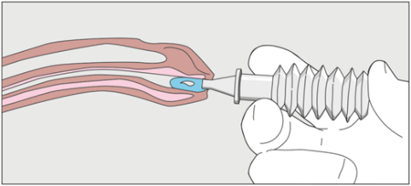
Preparing for catheter insertion
External lubricating gel instillation
Internal lubrication gel instillation
Coating only the outside of catheter results in less gel in the urethra as gel is pushed off at the entrance
May increase the risk of pain and injury from stretching and friction as the catheter opens the urethra
Instilling gel into urethra gently dilates the urethra, filling the urethra with an even coating of lubrication
Catheter then pushes gel ahead into an open pre-lubricated passage, reducing the risk of injury and trauma
Cross-section view of instilling lubricating gel with a syringe into a male urethra.

Slide 23
Lubricants and Sterile Lubricating Jelly With Local Anesthetics
Jelly for external lubrication of catheters
Jelly for internal insertion of lubrication
J
J
Select the correct jelly for insertion
Jelly should be highly viscous
Adheres to catheter or urethral lining

Slide 24
Sterile Lubricating Jelly With Local Anesthetic
Avoid the use of local anesthetic gel in the presence of damaged or bleeding urethral membranes due to increased risk of systemic absorption
Check for lidocaine sensitivity if using a lubricant containing lidocaine
Follow manufacturer's recommendations on the length of time the jelly must be instilled and held in place, prior to CIC procedure, to get anesthetic benefit.
( Recommendations found on page 32 of Clean Intermittent Urethral Catheterization in Adults – Canadian Best Practice Recommendations for Nurses. Developed by Nurses Specialized in Wound, Ostomy and Continence Canada, Canadian Nurse Continence Advisors, Urology Nurses of Canada, and Infection Prevention and Control.1st Ed. 2020.)

Slide 25
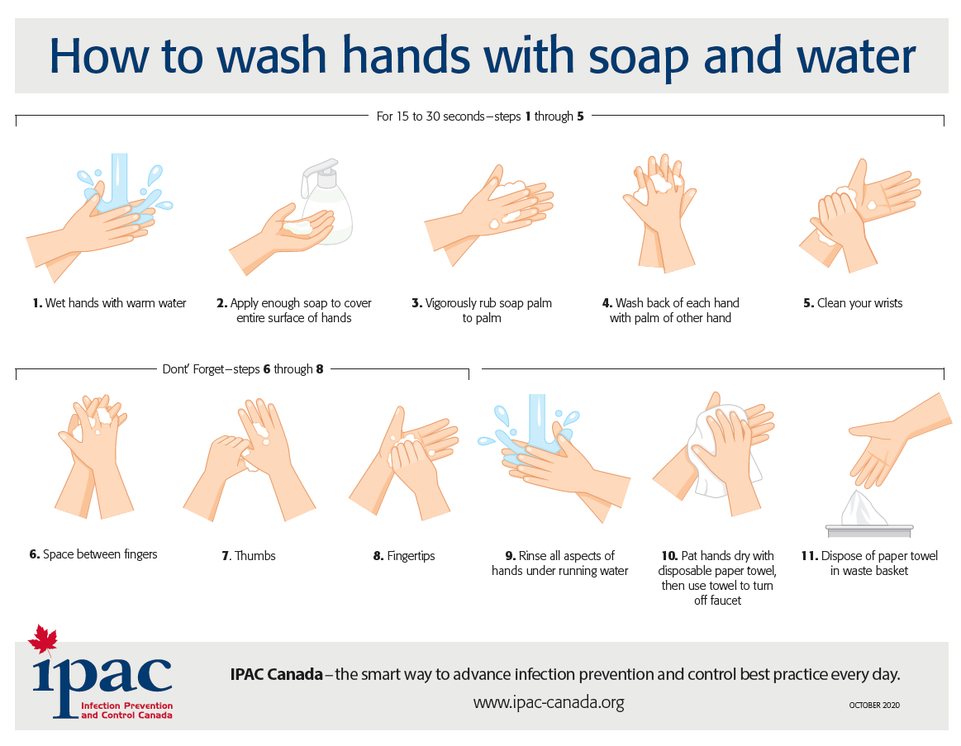
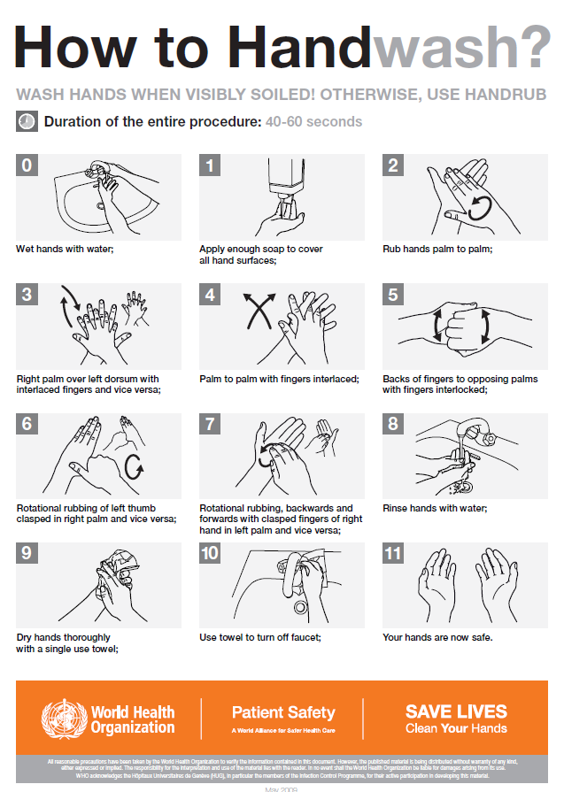
Hand hygiene
https://ipac-canada.org/hand-hygiene.php
https://www.who.int/campaigns/world-hand-hygiene-day
Notes:
If your institution does not have a handout or printable poster for hand washing, there are a variety of hand hygiene posters available from reputable and reliable websites on the internet. Many can be printed and given to patients as a helpful reminder of proper hand washing techniques.

Slide 26
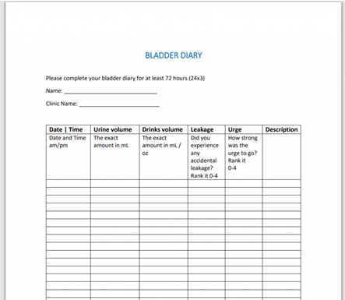
Bladder Diary
(Clean Intermittent Urethral Catheterization in Adults – Canadian Best Practice Recommendations for Nurses. Developed by Nurses Specialized in Wound, Ostomy and Continence Canada, Canadian Nurse Continence Advisors, Urology Nurses of Canada, and Infection Prevention and Control.1st Ed. 2020.)
https://iuflow.com/tag/bladder-diary-printable/
Notes:
Valuable tools to assess patient prior to teaching and to help make appropriate adjustments to the individual patient’s schedule based on their intake and output.

Slide 27
Helpful Tips
Supply patients with written information as well as verbal
Send out information in advance where possible
Demonstrate technique and have them do the same
Repeat instructions several times through out the teaching process
Provide on going support and follow up
Do not underestimate the power of “Vocal anesthetic”.
Instruct patient to have a second catheter on hand in the event the first one becomes contaminated
(Clean Intermittent Urethral Catheterization in Adults – Canadian Best Practice Recommendations for Nurses. Developed by Nurses Specialized in Wound, Ostomy and Continence Canada, Canadian Nurse Continence Advisors, Urology Nurses of Canada, and Infection Prevention and Control.1st Ed. 2020.)
Notes:
Vocal anesthetic is simply taking the time to help the patient learn to relax and calm themselves through breathing and focused relaxation, before and during the CIC procedure. This can greatly reduce discomfort and goes hand in hand with ensuring enough time is allotted for the teaching session. Letting the patient know they can return or call f they are having any difficulties helps to alleviate their fears.

Slide 28
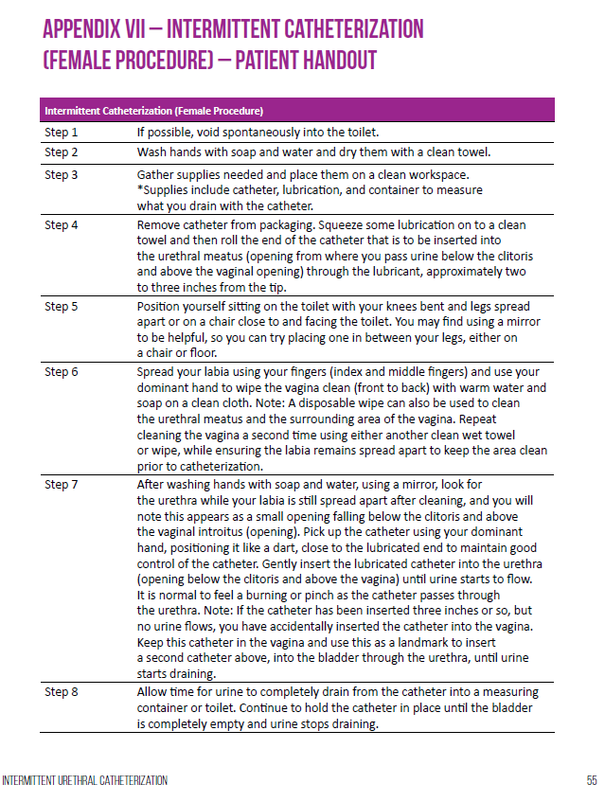
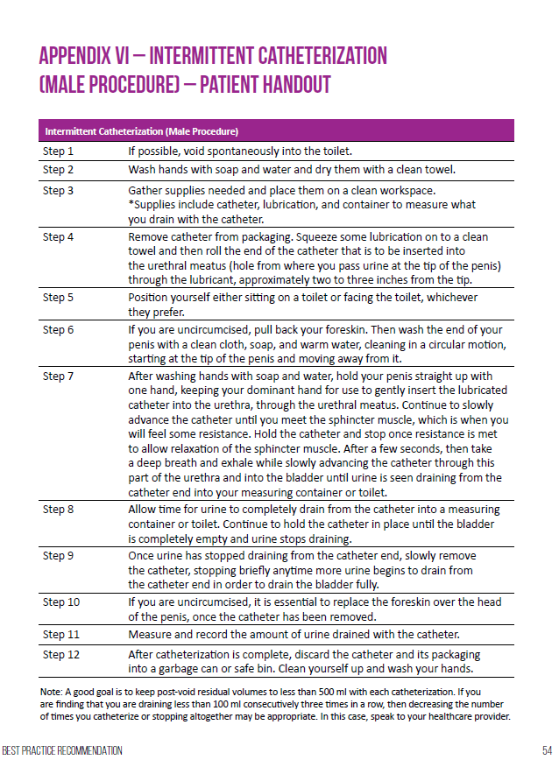
Patient Leaflets/ Handouts
(Clean Intermittent Urethral Catheterization in Adults – Canadian Best Practice Recommendations for Nurses. Developed by Nurses Specialized in Wound, Ostomy and Continence Canada, Canadian Nurse Continence Advisors, Urology Nurses of Canada, and Infection Prevention and Control.1st Ed. 2020.)
Notes:
These are printable from the Best Practice Recommendations and are for use with your patients if you do not already have such resources.
The Patient Leaflet supplies some basic information and the Patient Handouts give step by step instructions on how to carry out the Intermittent Catheterization procedure.

Slide 29
Thank you for your time and attention!!
QUESTIONS???

